Slide 1
Bee Campus USA
An Initiative of The Xerces Society for Invertebrate Conservation
Photo: Sara Morris
Notes:
{{This presentation is an introduction to pollinators and how to protect them through becoming an affiliate of Bee Campus USA. There is suggested text with each slide. The presentation should take about 15 minutes.}}
Hello, my name is [NAME] and I am the [JOB TITLE] at [EMPLOYER]. Thank you so much for joining me today to learn about the Bee Campus USA initiative and how [COLLEGE OR UNIVERSITY NAME] can join this nationwide network of campuses supporting native pollinators.

Slide 2
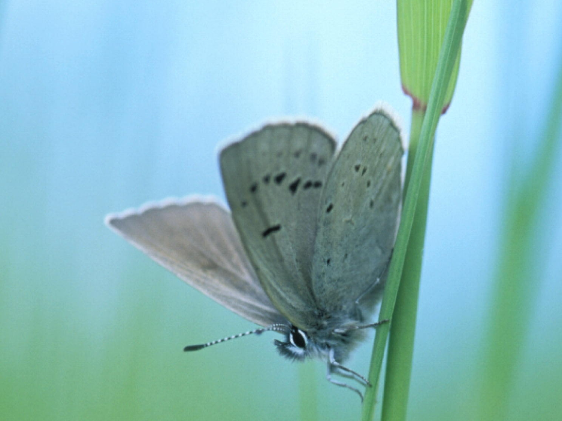
The Xerces Society
Protecting the life that sustains us
Since 1971, the Xerces Society has worked to protect wildlife through the conservation of invertebrates and their habitat.
Photo: Endangered Fender’s blue butterfly (Icaricia icarioides fenderi) by Dana Ross
Notes:
Bee City USA is an initiative of the Xerces Society for Invertebrate Conservation. Established in 1971, the Xerces Society is at the forefront of invertebrate protection, harnessing the knowledge of scientists and enthusiasm of citizens to implement conservation programs worldwide. Xerces uses advocacy, education, and applied research to conserve invertebrates and their habitat.

Slide 3
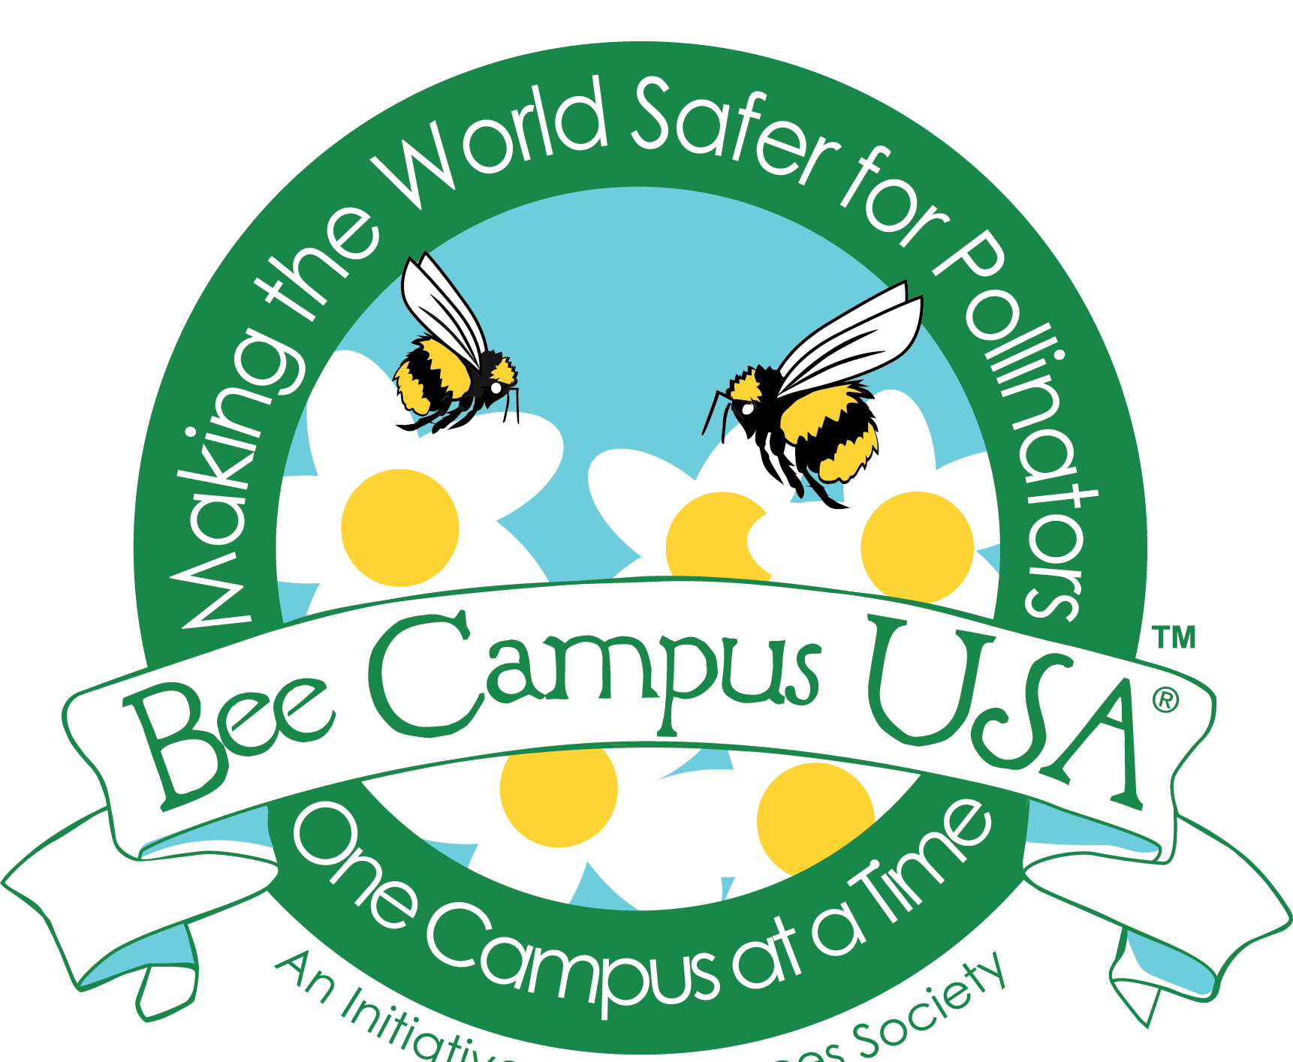
Bee Campus USA
Bringing communities together to sustain pollinators, in particular the more than 3,600 species of native bees in this country, by increasing the abundance of native plants, providing nest sites, and reducing the use of pesticides.
Notes:
The Bee Campus USA initiative, and it’s sister initiative Bee City USA, bring communities together to sustain native pollinators and in particular the more than 3,600 species of native bees in this country. Campuses commit to increase the abundance of native plants, provide nest sites, and reduce pesticide use. Affiliates also incorporate pollinator conservation into education and outreach events. Bee Campus’ sister initiative, Bee City USA, works with cities and counties.

Slide 4
Bee Campus USA
Bringing communities together to sustain pollinators, in particular the more than 3,600 species of native bees in this country, by increasing the abundance of native plants, providing nest sites, and reducing the use of pesticides.
Notes:
Later in this presentation I’ll go over the commitments in more depth, walk through the application process, and discuss advantages of joining the initiative, but I want to start by briefly taking a closer look at what we mean when we talk about conserving native pollinators.

Slide 5
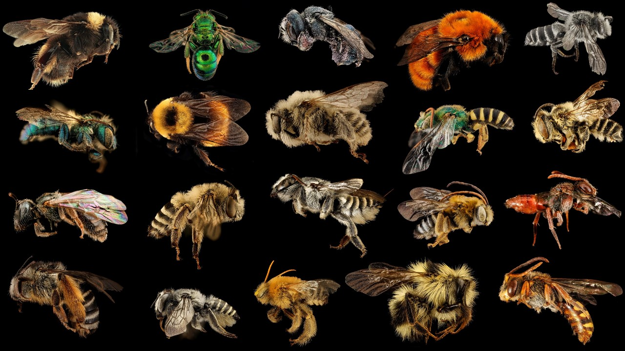
Bee Diversity
USGS Native Bee Inventory and Monitoring Lab
Notes:
Most people are surprised to learn that there is so much diversity in the world of bees. There are in fact seven distinct families of bees that vary hugely in their appearance as well as their strategies for nesting, eating, and interacting with others of their species.

Slide 6
Honey Bees
Notes:
When people hear the word “bee” they often think of one bee species, Apis Mellifera, or the European honey bee. Honey bees are a social species, making them ideal for use in agriculture.

Slide 7
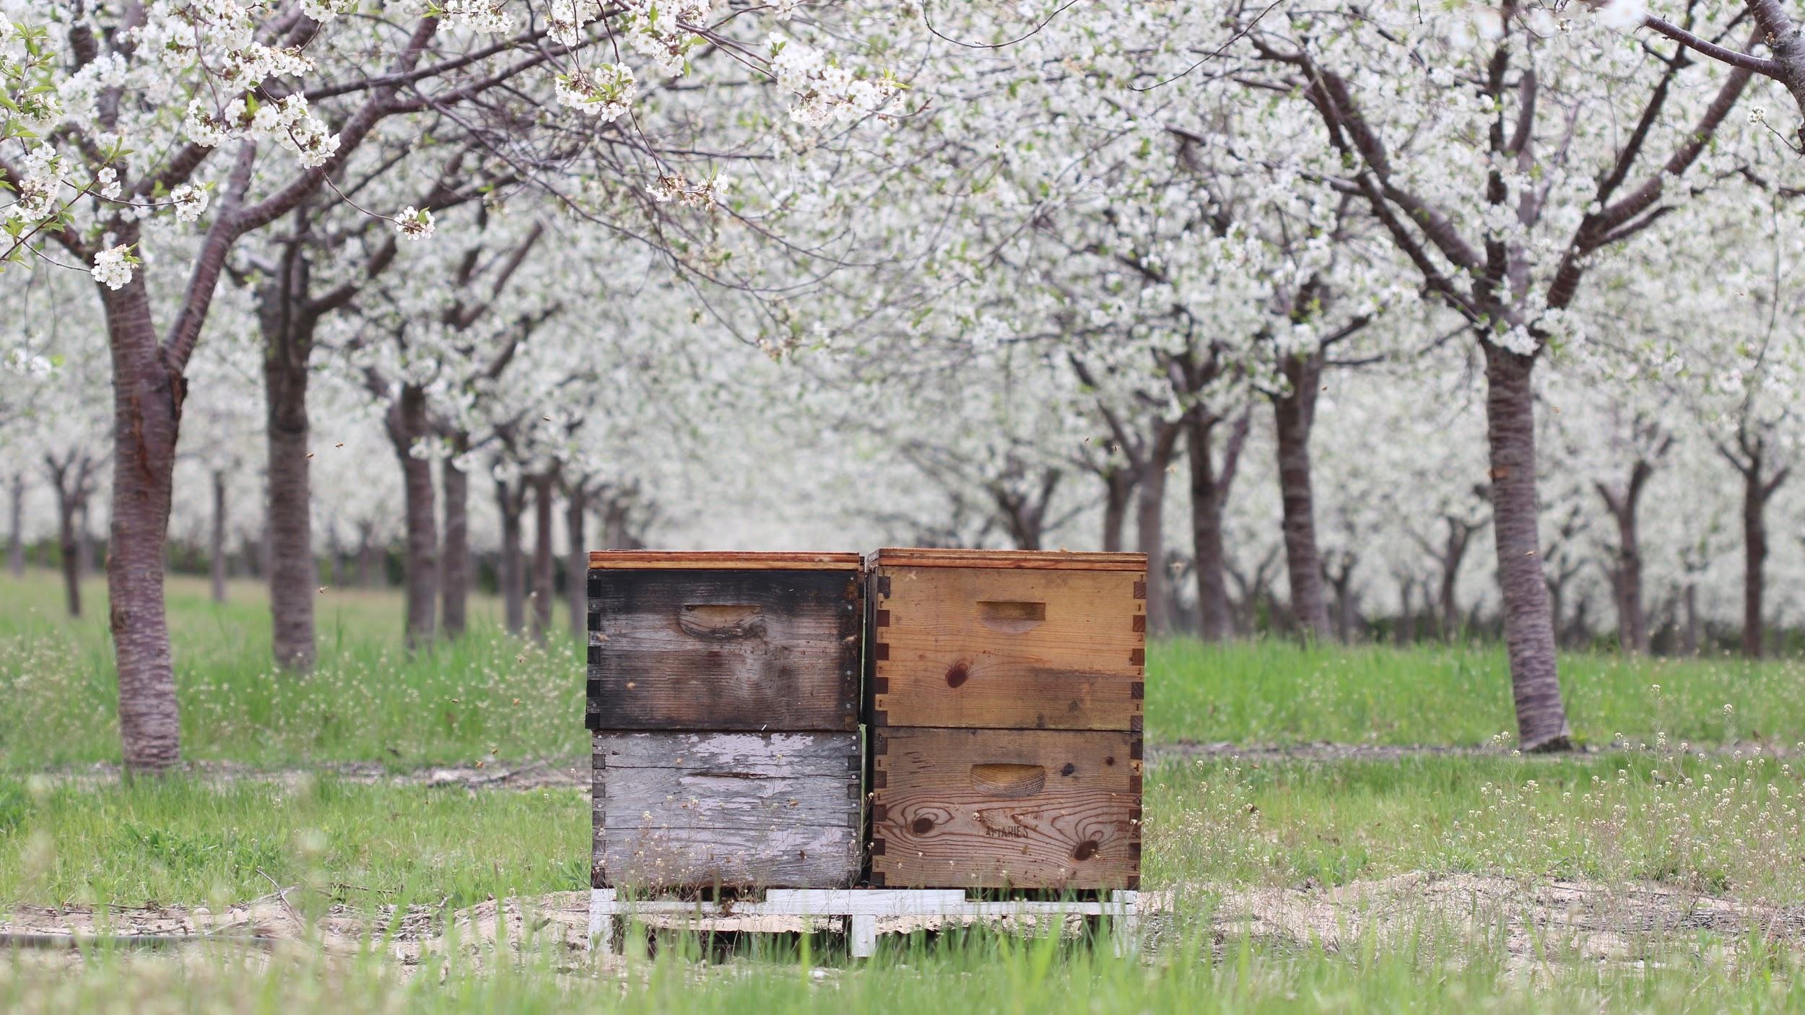
Photo: Emily May
Notes:
While honey bees are integral to our current food system, the European honey bee is not native to the united states but was brought to North America from Europe in the 1600s. The United States is also home to around 3,600 native bee species. While honey bees will feed on a wide variety of native and non-native plants, native pollinators are more dependent on the native plants that they evolved alongside.

Slide 8
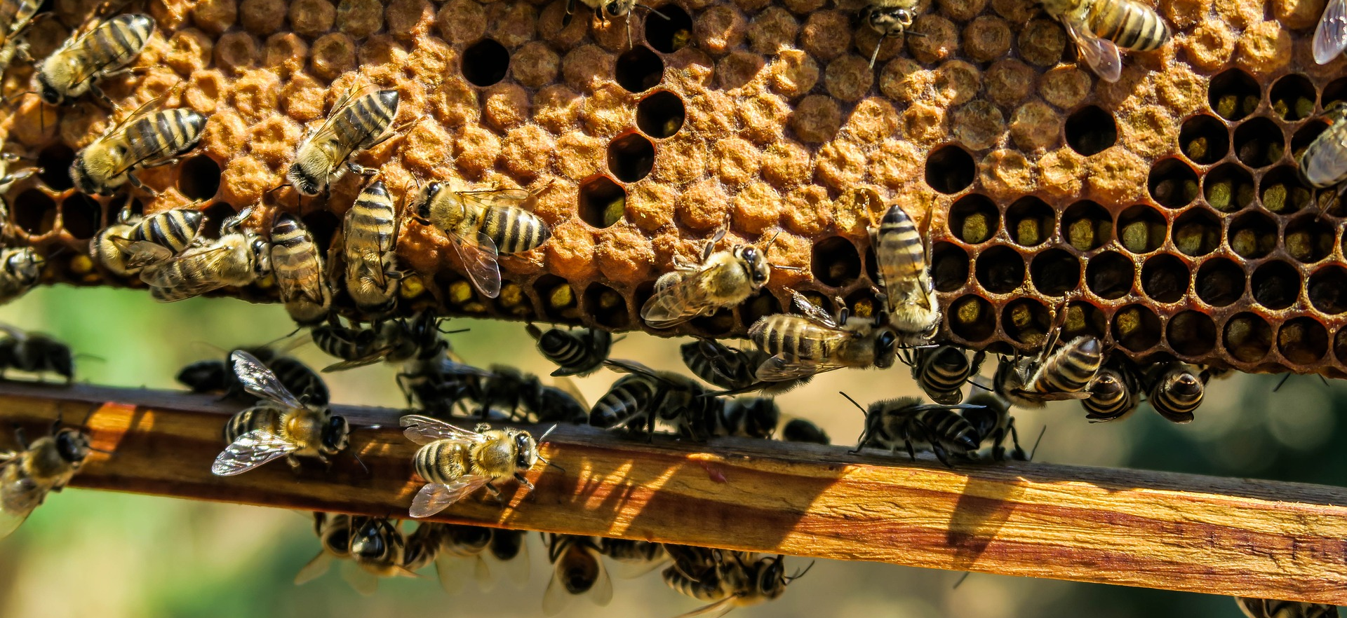
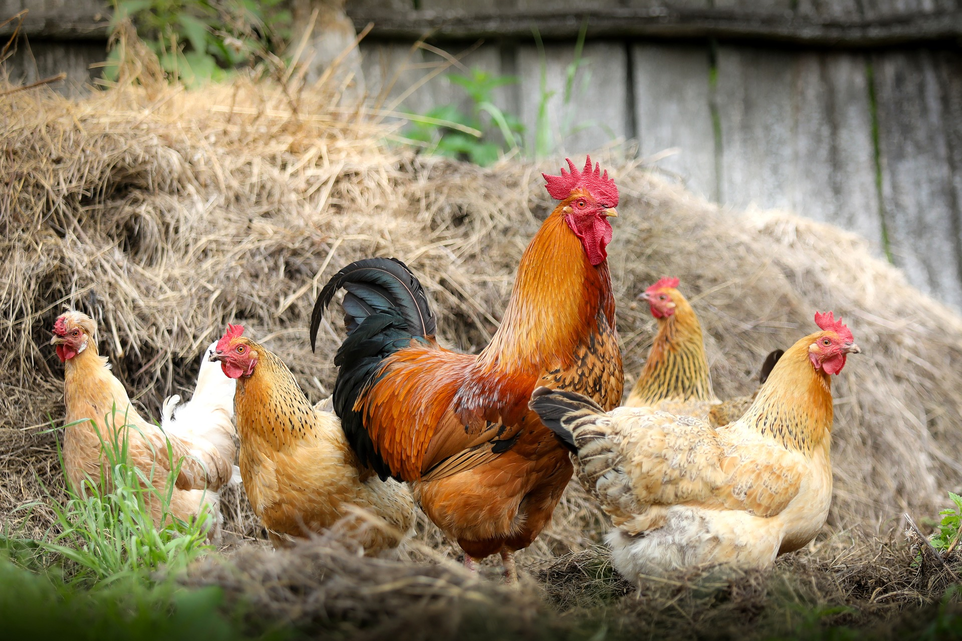
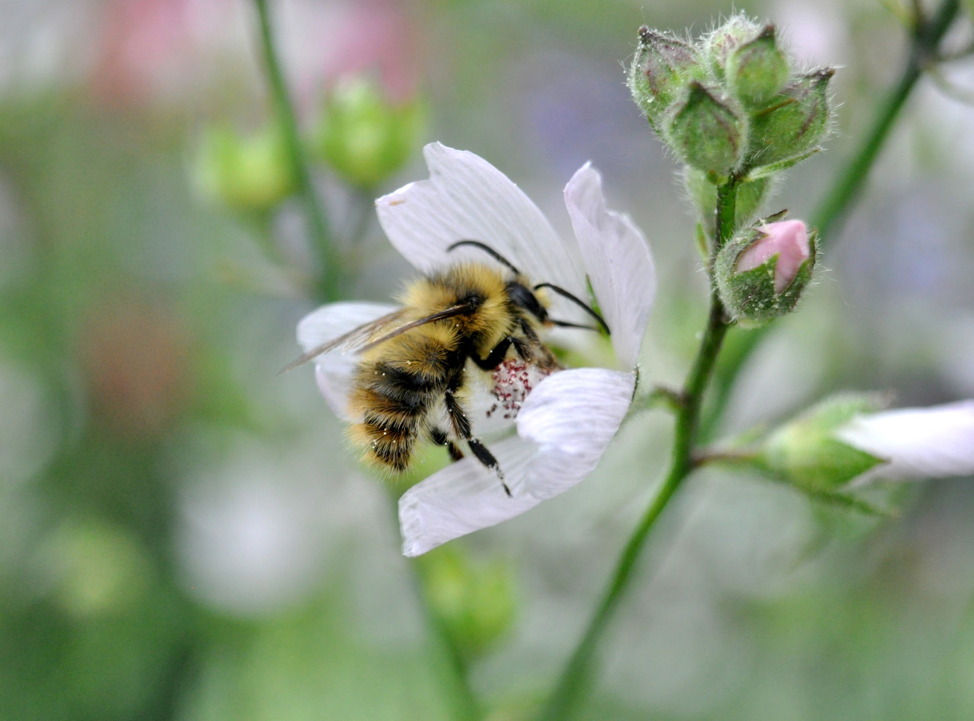
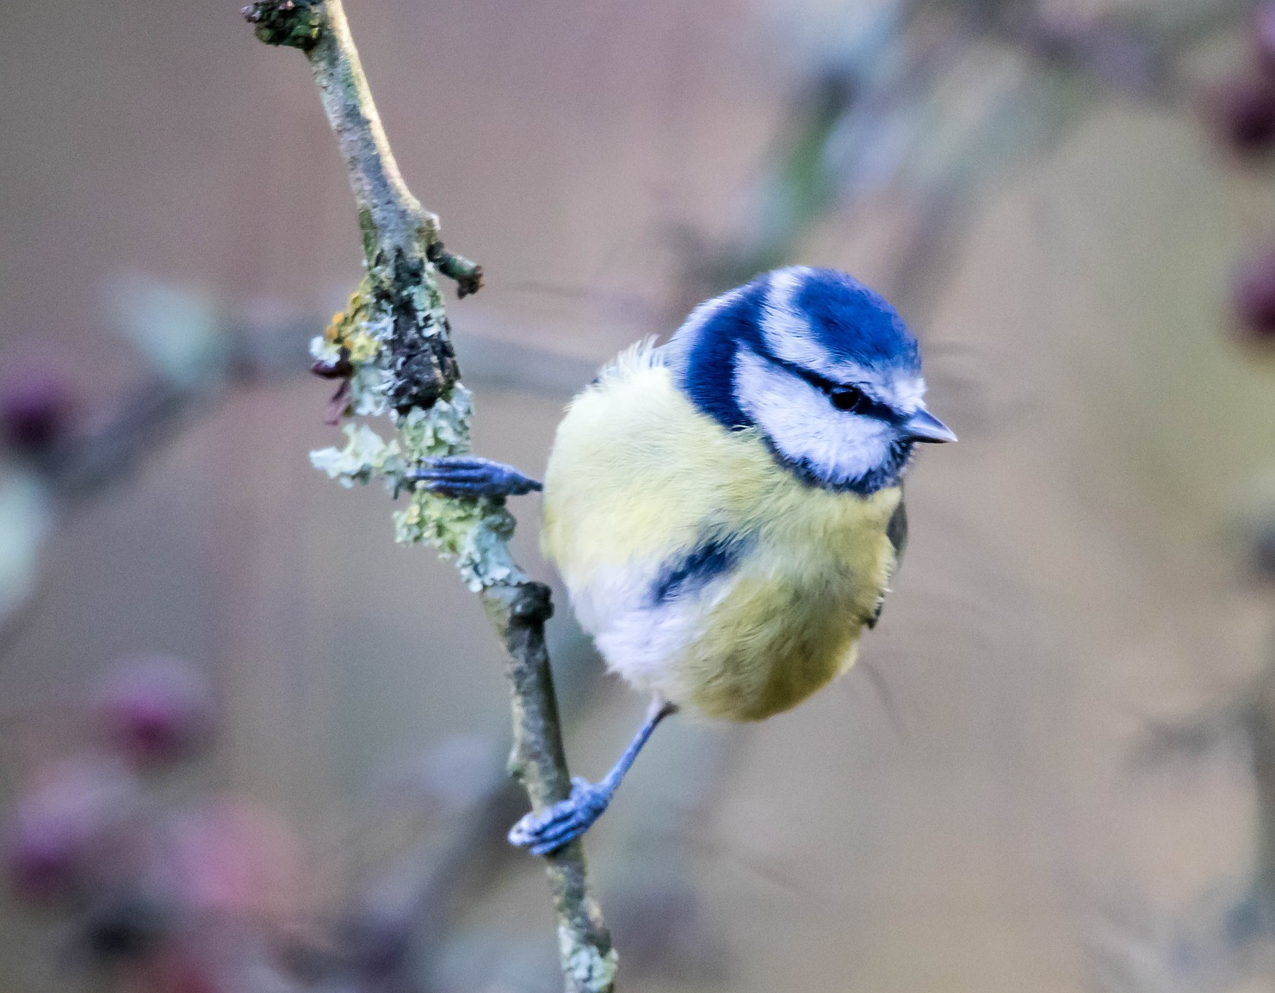
Beekeeping ≠ Bee Conservation
Notes:
Bee City USA neither encourages nor discourages beekeeping, but the focus of the program is not honey bees. Beekeeping can be a fun hobby or business opportunity but keeping honey bees is not the same as conserving native pollinators. Keeping honey bees in an effort to conserve native bees is the equivalent of keeping chickens in hopes of conserving native songbirds. Taking the steps to conserve native pollinators will also help honey bees. In fact, many Bee Campus USA and Bee City USA affiliates are beekeepers in addition to their work on native bee conservation.

Slide 9
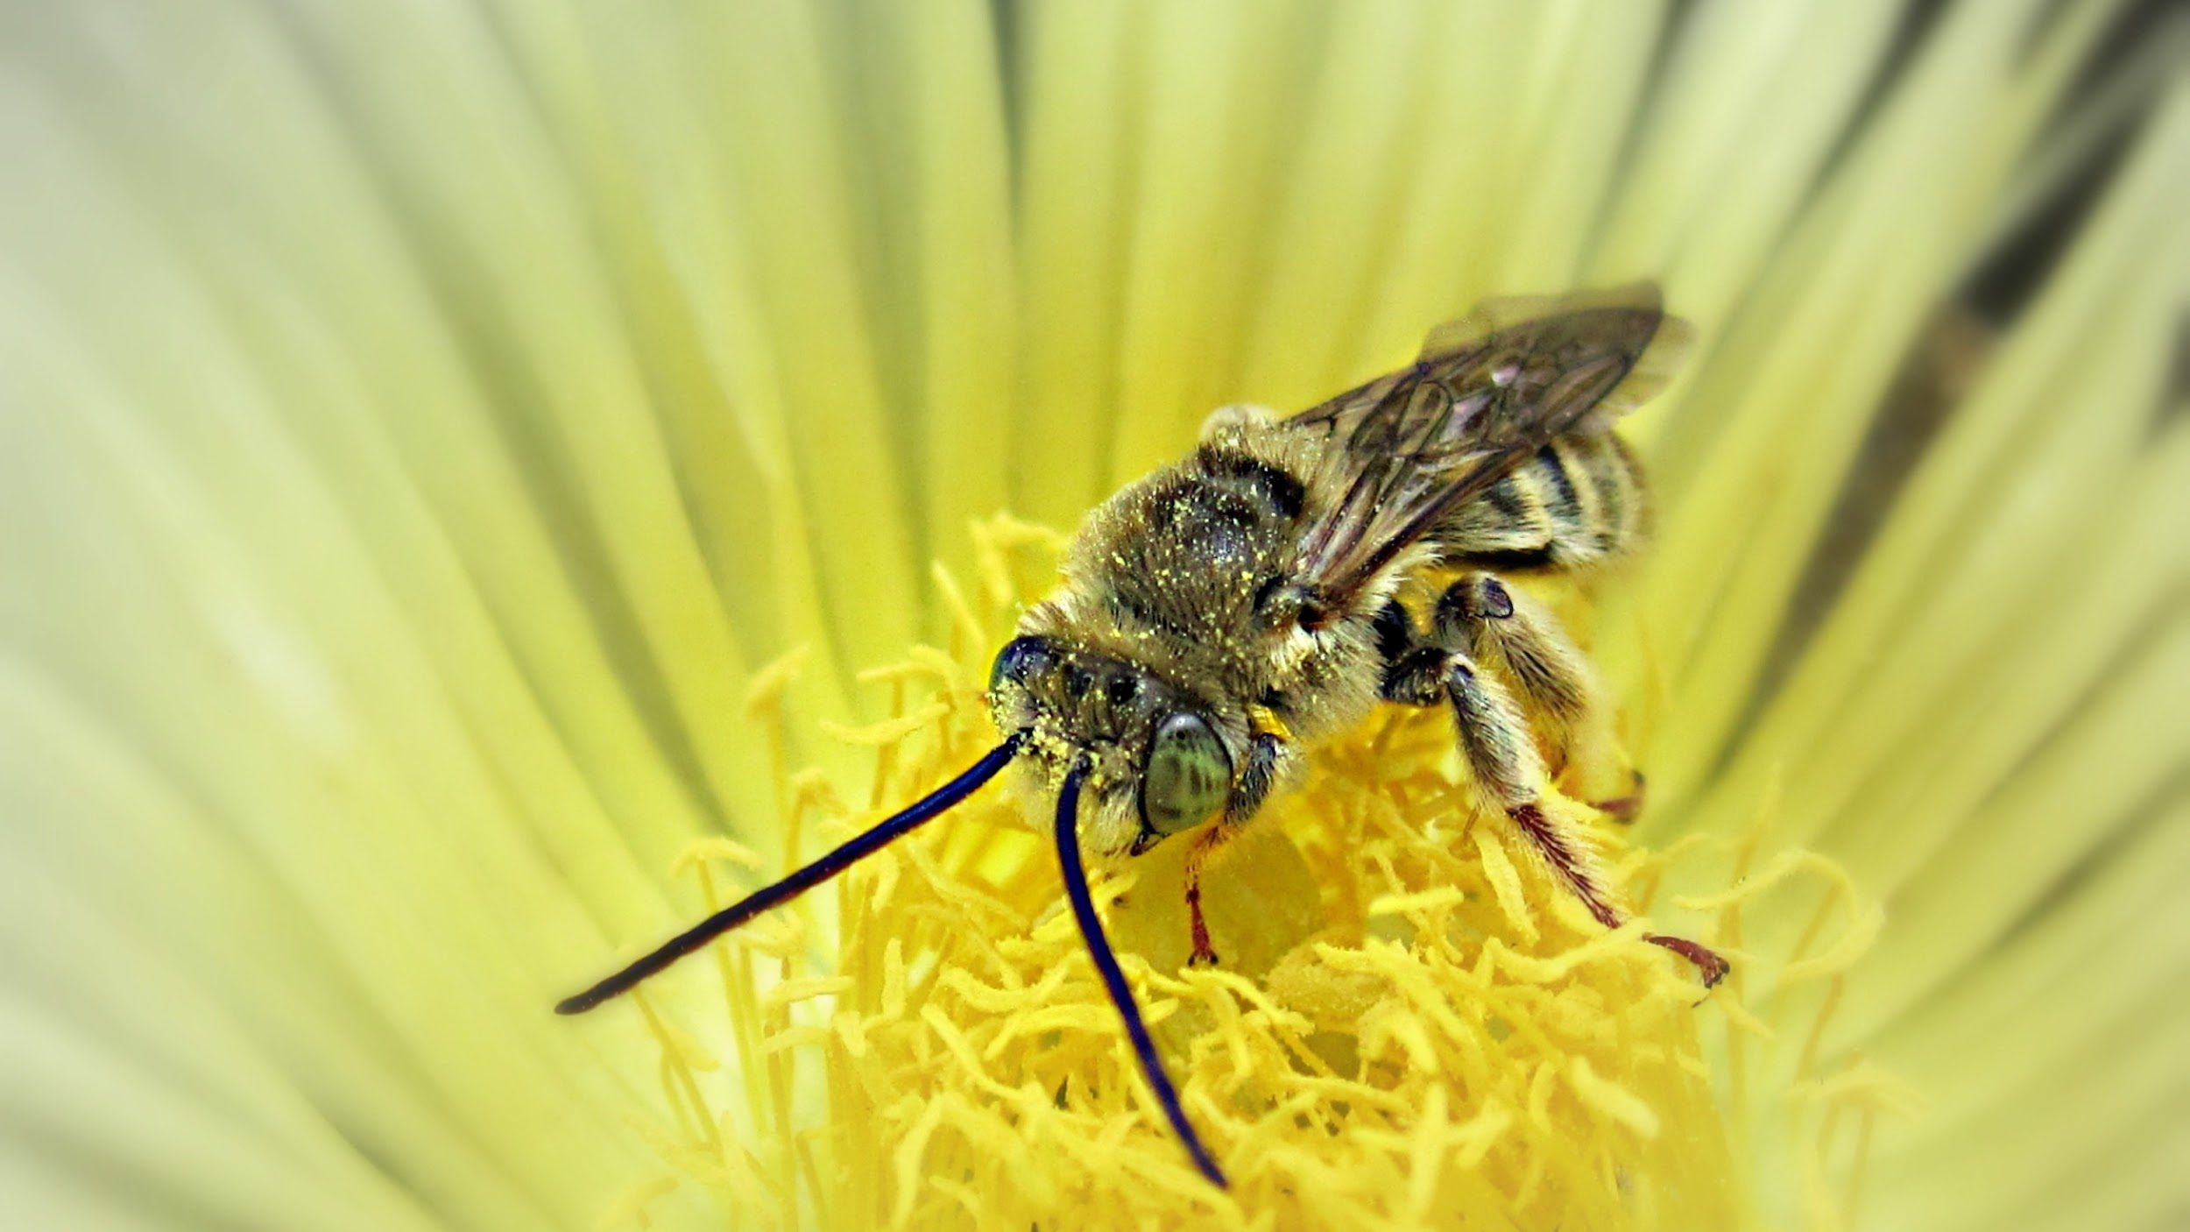
Notes:
As I said earlier, the US is home to around 3,600 species of native bees. Between 25 and 30% of these species are considered “specialists”, meaning they will only collect pollen from certain types of plants. Before we dive into why conserving pollinators is important I want to show you a few pictures displaying the diversity of native bees. Bees can vary hugely in size, color, and overall appearance. This is a long-horned bee.

Slide 10
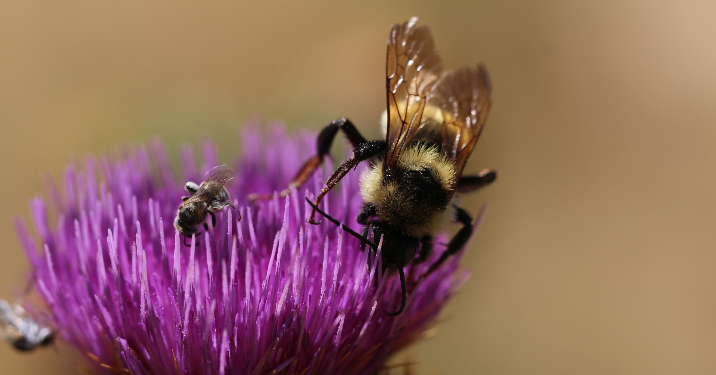
Photo: Stephanie McKnight / Xerces
Notes:
And here is a bumble bee and a tiny solitary bee collecting nectar and pollen from the same thistle flower.

Slide 11
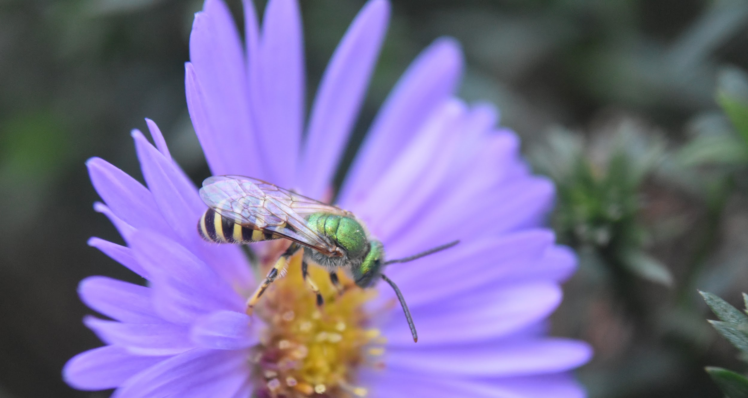
Photo: Sara Morris / Xerces
Notes:
Bees can also have nearly hairless, colorful, metallic bodies like this green metallic sweat bee.

Slide 12
Bee Diversity
Number of species
USA & Canada
Oregon
Portland
In a single garden
3,600
600–800?
80–100?
20–30
Notes:
The bottom line is, there are a whole lot of bee species. There are 20,000 species of bees globally, and around 3,600 species in the US and Canada. In Oregon, where the Xerces Society is based, there are between 600 and 800 species of native bees, and 80 to 100 in the city of Portland. In the Portland area there are likely 20 to 30 native bee species in a single garden.

Slide 13
Other Pollinators
Butterflies
Moths
Beetles
Flies
Photos: Dennis Burnette, Stephanie McKnight, Whitney Cranshaw, Scott Horvath
Notes:
Bees aren’t the only species that pollinate plants. Other groups that contribute to pollination include butterflies, moths, beetles, and flies. Hummingbirds and bats also pollinate some plants.

Slide 14
Why Care About Pollinators?
Photo: Rich Hatfield
Notes:
Now that we’ve talked about the diversity of native bees I want to share some of the reasons you should care about and take steps to protect pollinators.

Slide 15
Plant Reproduction
Photo: Sarah Foltz Jordan
Notes:
Approximately 85% of flowering plants require a pollinator to transfer pollen and allow fertilization of the flower.

Slide 16
Food Production
Notes:
Pollinators are also responsible for a component of one in every three mouthfuls of food and drink we consume. In the United States alone the value of crop pollination has been estimated at between $18 and $27 billion dollars.

Slide 17
Ecological Role
Pollinators are at the center of complex food webs.
They enable the fruits and seeds that make up a major part of the diet of many animals.
And sometimes they are the food themselves.
Photos: Wildreturn, Flickr; Colleen Prieto, Flickr; U.S. Forest Service; kansasphoto, Flickr.
Notes:
Pollinators are a keystone species in almost all ecosystems. They enable the growth of fruits and seeds that make up a major part of the diet of many animals and are also a staple in the diets of a variety of other species.

Slide 18
Enrich our Lives, Define our Seasons
Photo: Molly Martin
Notes:
If you like springtime flowers, summer berry picking, pumpkins at Halloween, pie at thanksgiving, or a bowl of salsa with fresh garden tomatoes then you also like pollinators.

Slide 19
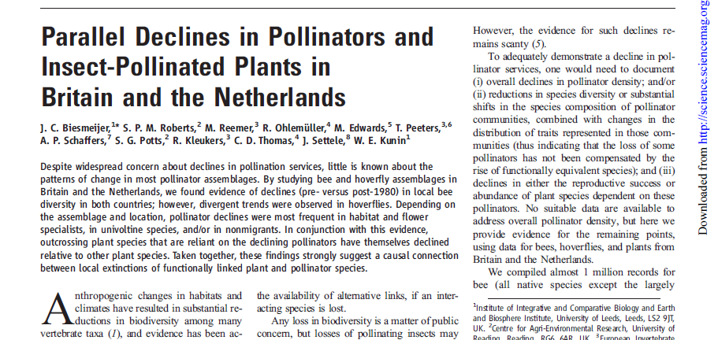
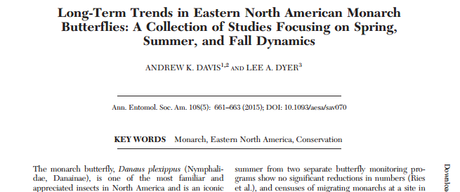
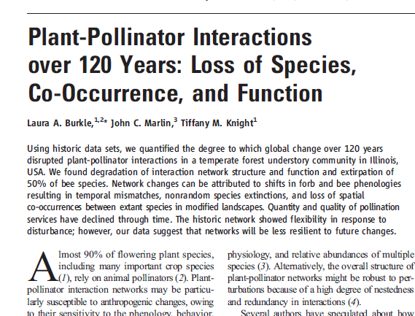
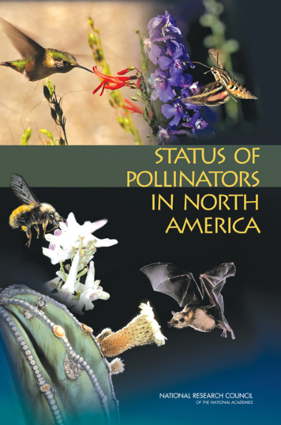
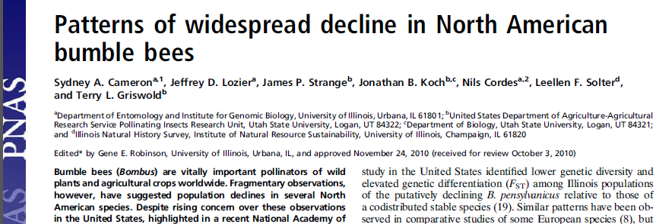
The Science is Clear: Pollinators are in Peril
Notes:
As you likely already know, pollinators are in trouble. Dozens of studies show that pollinators are in decline globally.

Slide 20
Pollinator Declines
Globally: Up to 40% of pollinator species may be at risk of extinction in the coming years.
North America: More than a quarter of bumble bees species are in decline
Photo: Rusty-patched bumble bee (Bombus affinis), Rich Hatfield
Source: Assessment report of the Intergovernmental Science-Policy Platform on Biodiversity and Ecosystem Services on pollinators, pollination, and food production.
Notes:
Worldwide, up to 40% of pollinator species may be at risk of extinction in the coming years. In North America alone more than a quarter of bumble bee species are in decline.

Slide 21
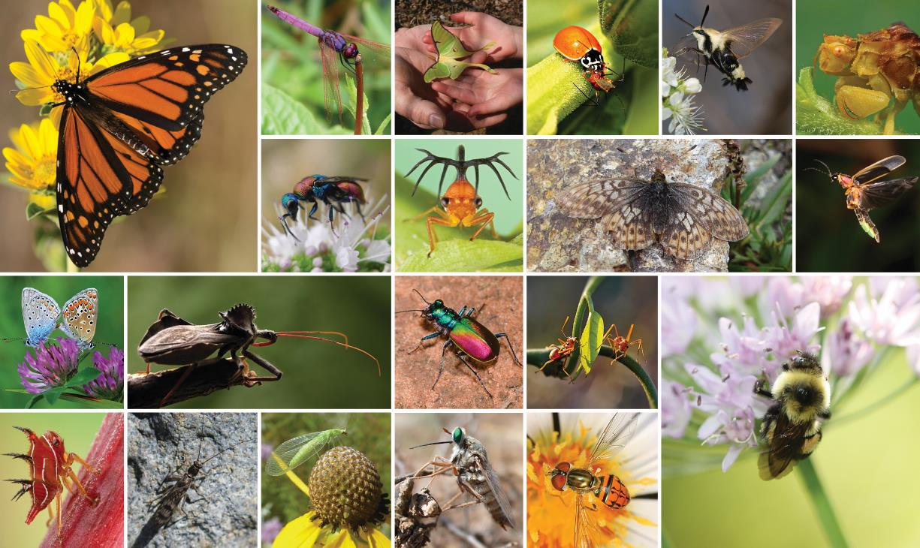
Other Insects in Trouble
Notes:
Unfortunately it’s not just pollinators that are declining. There’s evidence of declines in every group of insects that has been studied in many countries.

Slide 22
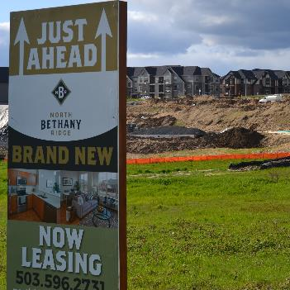
Drivers of Pollinator Declines
Habitat loss and degradation
Photos (L to R): Matthew Shepherd (2), Emily May, Pixabay
Notes:
The drivers of pollinator declines include a variety of environmental stressors. Among these are habitat loss and degradation,

Slide 23
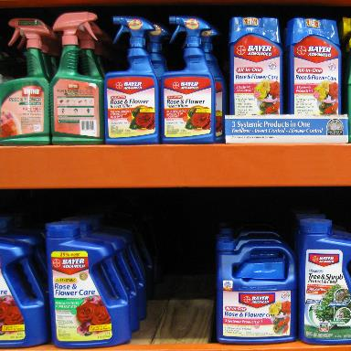
Drivers of Pollinator Declines
Habitat loss and degradation
Pesticide use
Photos (L to R): Matthew Shepherd (2), Emily May, Pixabay
Notes:
pesticide use,

Slide 24
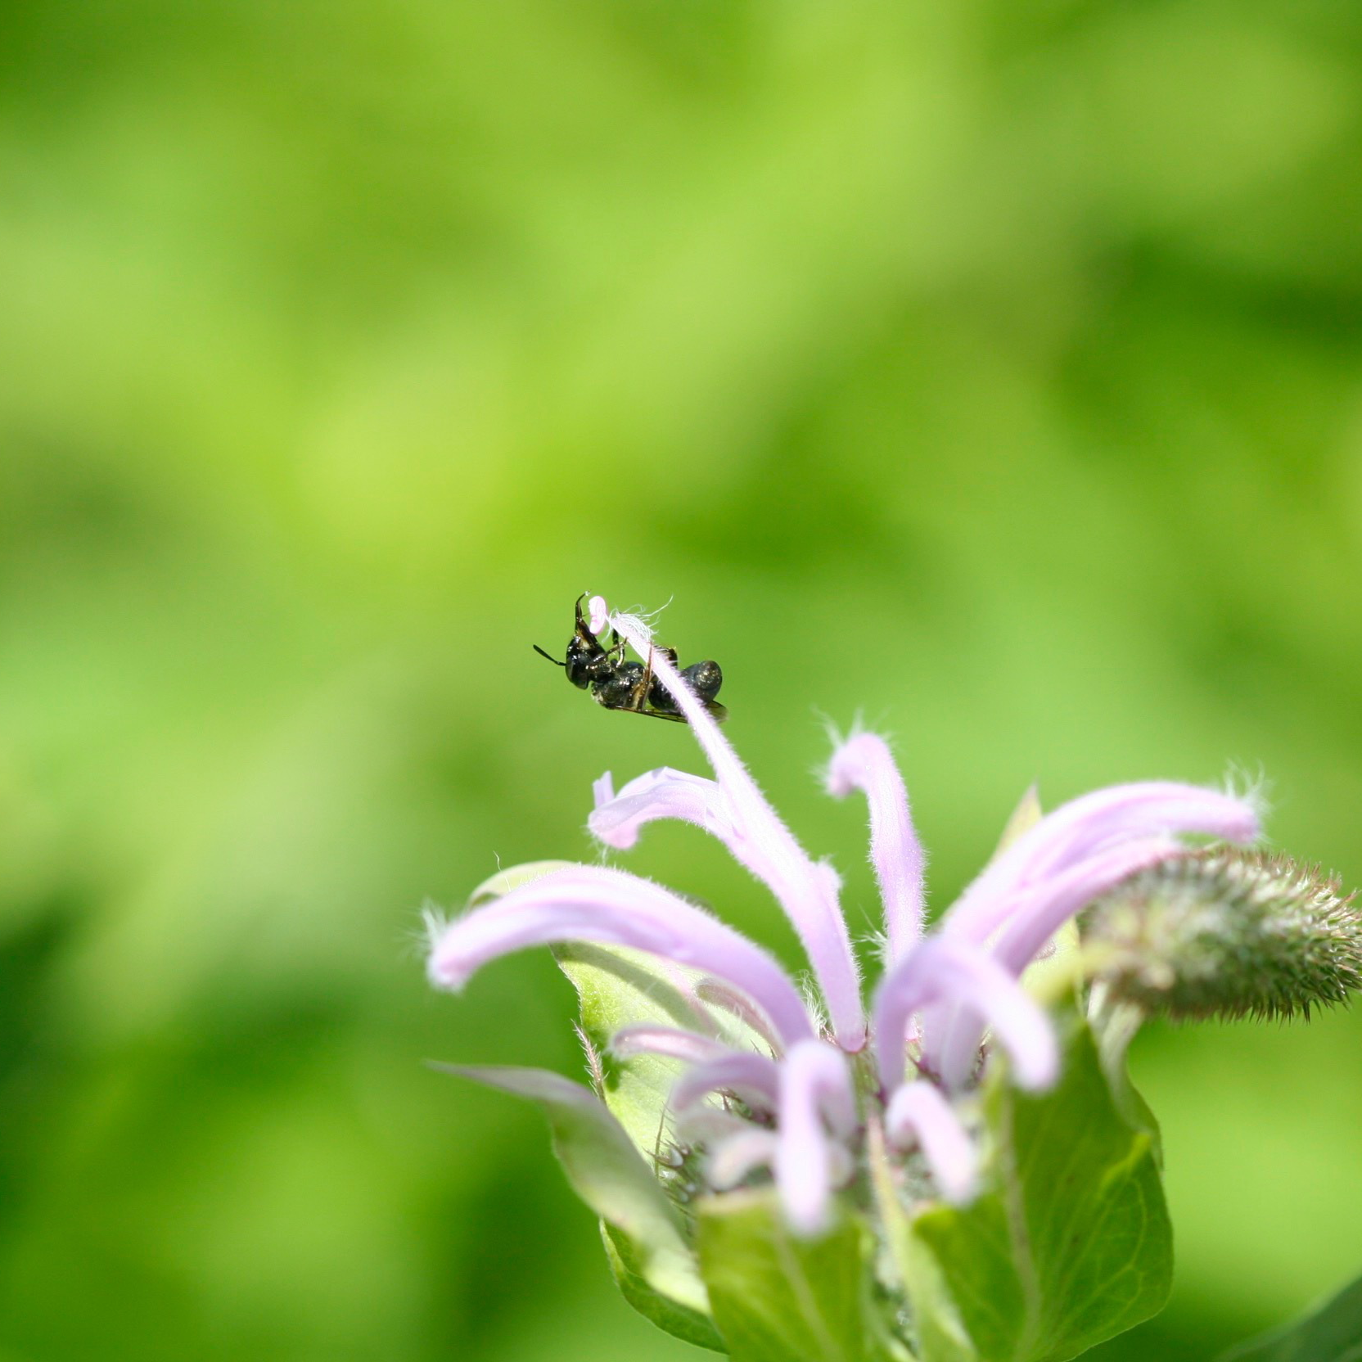
Drivers of Pollinator Declines
Habitat loss and degradation
Pesticide use
Diseases and pathogens
Photos (L to R): Matthew Shepherd (2), Emily May, Pixabay
Notes:
diseases and pathogens,

Slide 25
Drivers of Pollinator Declines
Habitat loss and degradation
Pesticide use
Diseases and pathogens
Climate change
Photos (L to R): Matthew Shepherd (2), Emily May, Pixabay
Notes:
and climate change.

Slide 26
Good News: There are Solutions
Photo: Matthew Shepherd
Notes:
The good news is that there are steps you can take to improve the outlook for pollinators. Many of these declining species frequent our neighborhoods, parks, and backyards. We can all help conserve these species through making slight adjustments to activities many of us already do like planting flowers, battling our backyard weeds, and raking leaves. We need to take steps at all levels to protect, restore, and enhance habitat for pollinators. Urban and suburban areas can play a key role in pollinator conservation, and Bee Campus USA provides a framework for campus communities to work together towards positive change.

Slide 27
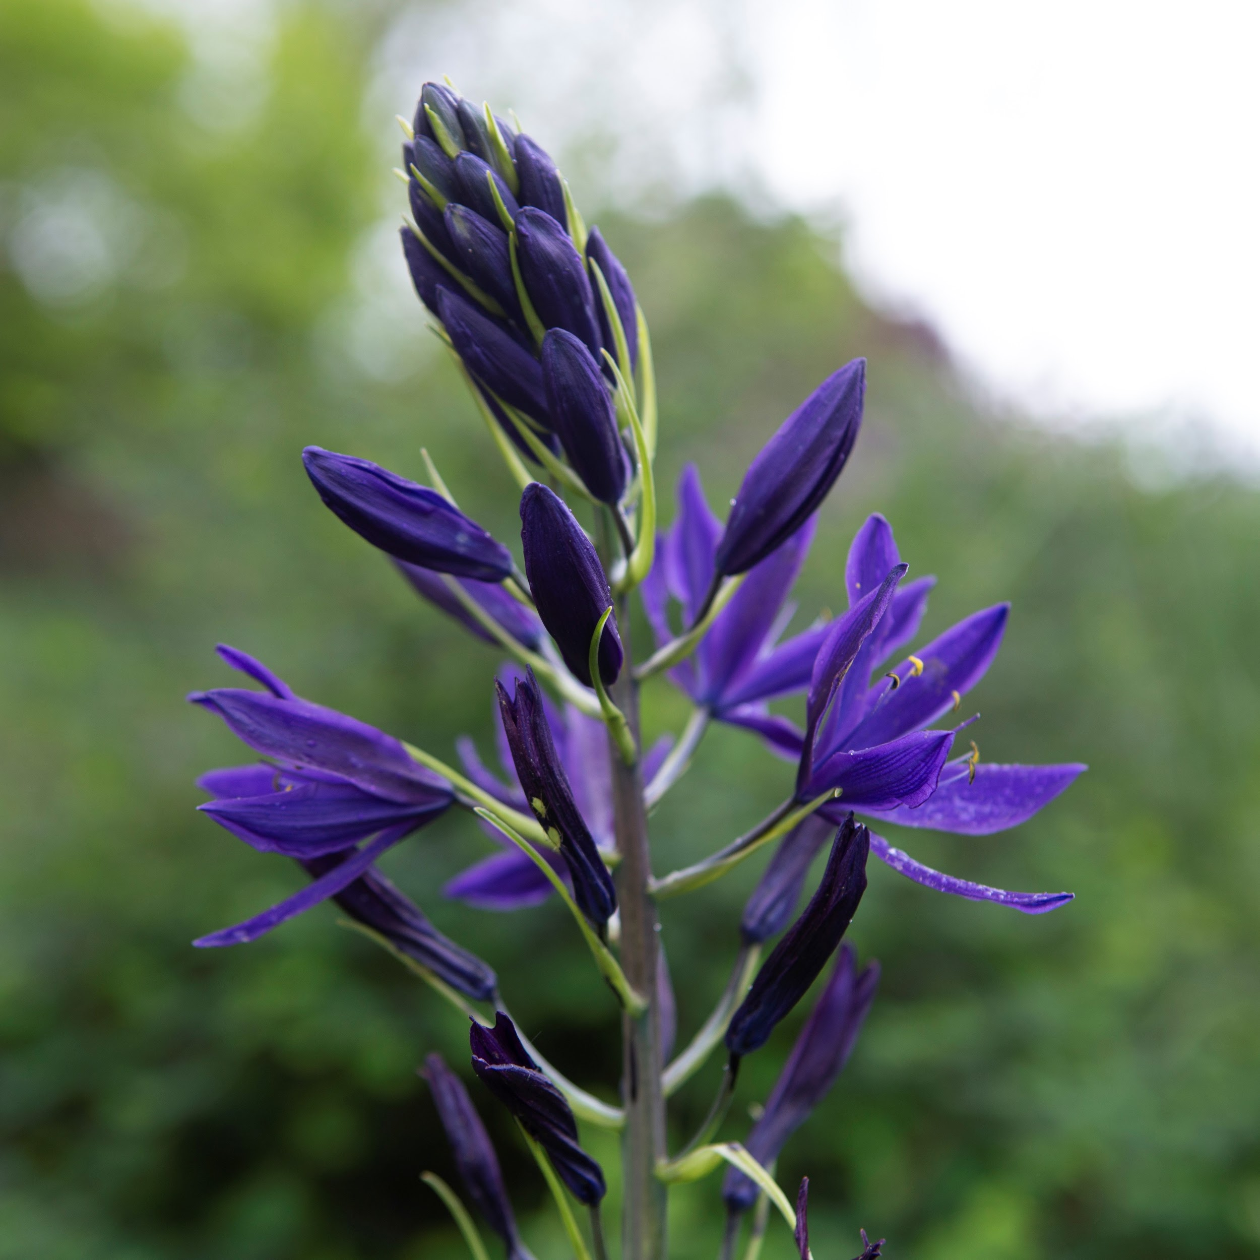
Pollinator Conservation Principles
Increase the availability of native flowering species
Photos (L to R): Sara Morris, Sara Morris, Jennifer Hopwood, Rachel Dunham
Notes:
Whether in urban areas or on rural or working lands, there are a few basic principles to conserve pollinators. These principles include:
Planting native species that evolved alongside our native pollinators and that bloom sequentially throughout the growing season.

Slide 28
Pollinator Conservation Principles
Increase the availability of native flowering species
Provide appropriate nesting substrates
Photos (L to R): Sara Morris, Sara Morris, Jennifer Hopwood, Rachel Dunham
Notes:
Providing areas for pollinators to nest including bare ground for ground nesting species, and pithy stems, rotting wood, and other materials for cavity nesters.

Slide 29
Pollinator Conservation Principles
Increase the availability of native flowering species
Provide appropriate nesting substrates
Find alternatives to harmful pesticides
Photos (L to R): Sara Morris, Sara Morris, Jennifer Hopwood, Rachel Dunham
Notes:
Finding alternatives to pesticides by implementing integrated pest management.

Slide 30
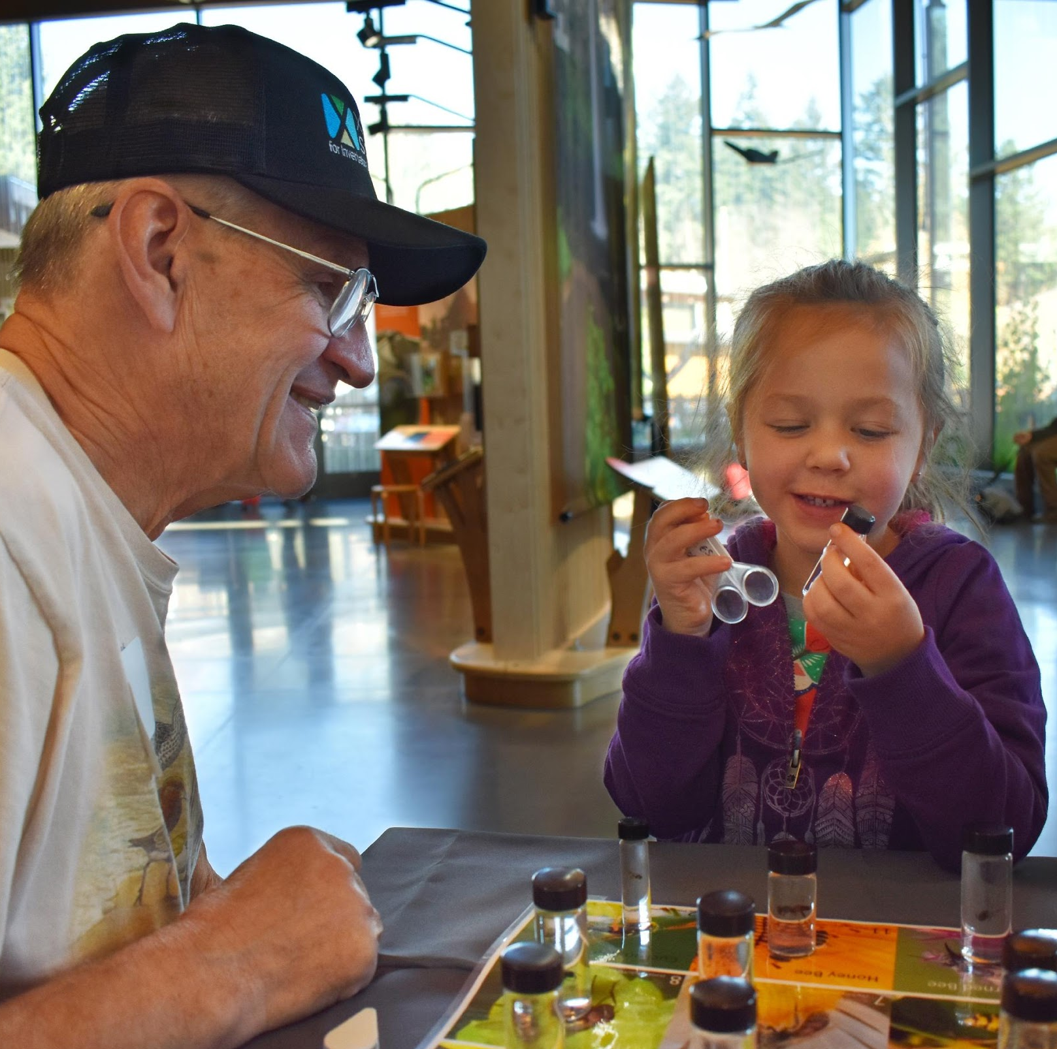
Pollinator Conservation Principles
Increase the availability of native flowering species
Provide appropriate nesting substrates
Find alternatives to harmful pesticides
Educate and spread awareness
Photos (L to R): Sara Morris, Sara Morris, Jennifer Hopwood, Rachel Dunham
Notes:
And finally, educating and spreading awareness. Creating habitat across a landscape requires large scale understanding of the threats pollinators face and opportunities for supporting them.

Slide 31
Current Cities & Campuses
City
Campus
Notes:
You can take these steps by becoming an affiliate of Bee Campus USA. Bee Campus USA is a certification program that supports and recognizes colleges and universities that are committed to protecting pollinators. A constantly expanding group of cities and college and university campuses have committed to conserving pollinators in their communities through becoming affiliates of Bee City USA and Bee Campus USA.

Slide 32
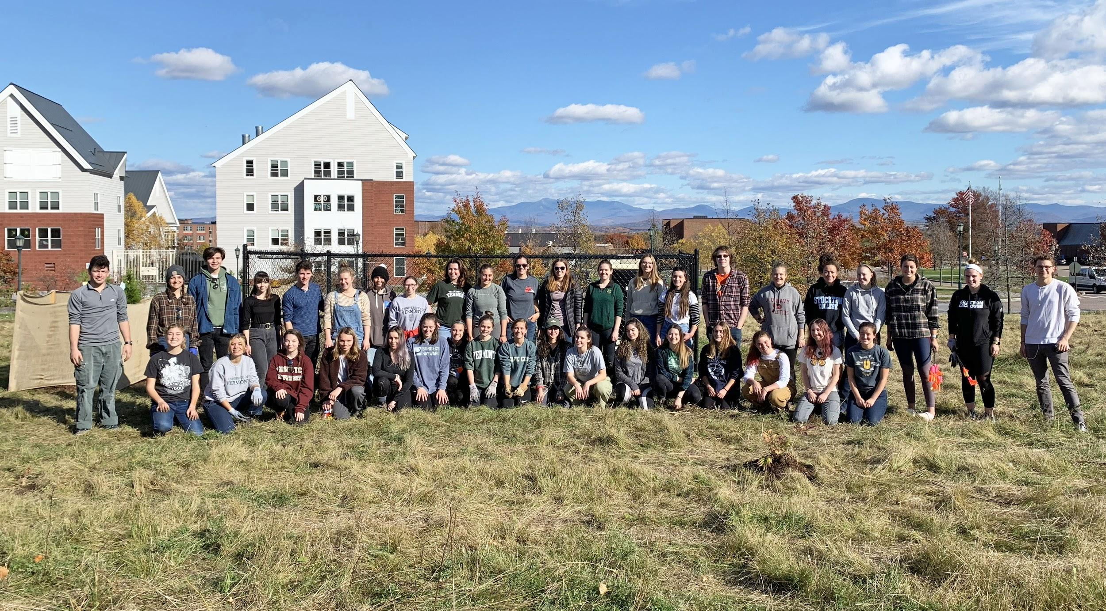
Bee Campus USA Commitments
Establish a standing Bee Campus USA committee to advocate for pollinators.
Notes:
To become a Bee Campus affiliate, campuses make a set of commitments. Campuses start by establishing a Bee Campus USA committee.

Slide 33
Bee Campus Committee
Faculty
Staff
Admin
Students
Notes:
This committee should include faculty, staff, a member of the landscaping or grounds crew, and students. The committee must include a members of the grounds or landscaping department and at least one co-chair should be a member of the faculty, staff, or administration. Students are welcome to be a co-chair as well, but a student can’t serve as the only chair to make sure a longstanding contact is maintained as students move through the school.

Slide 34
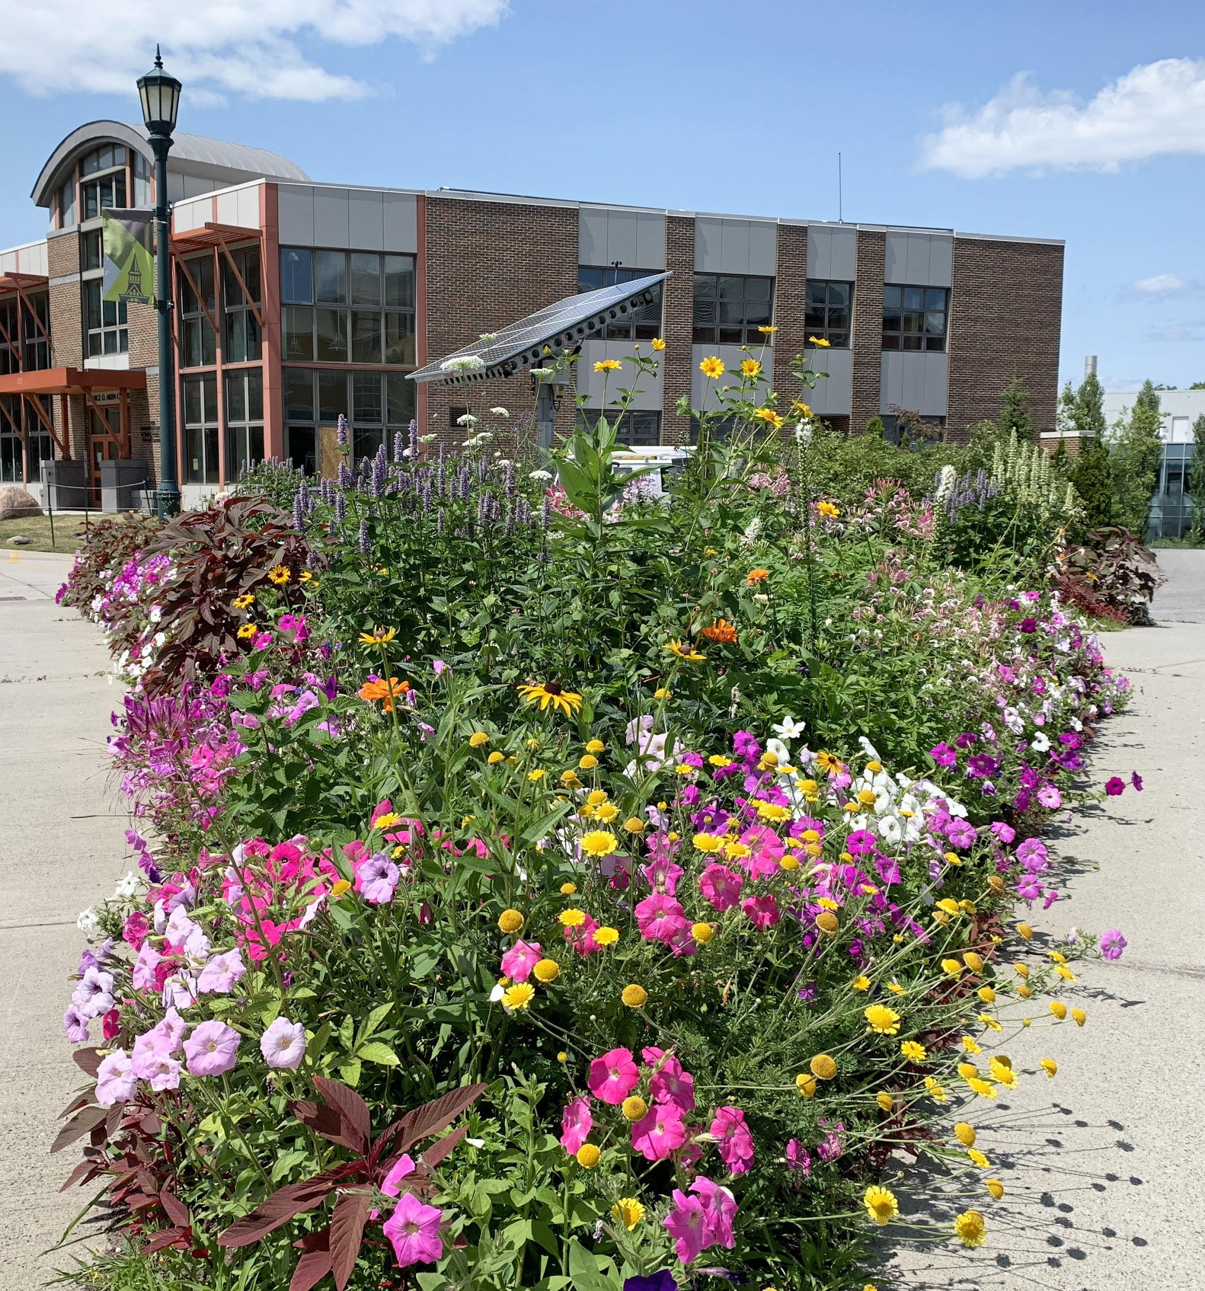
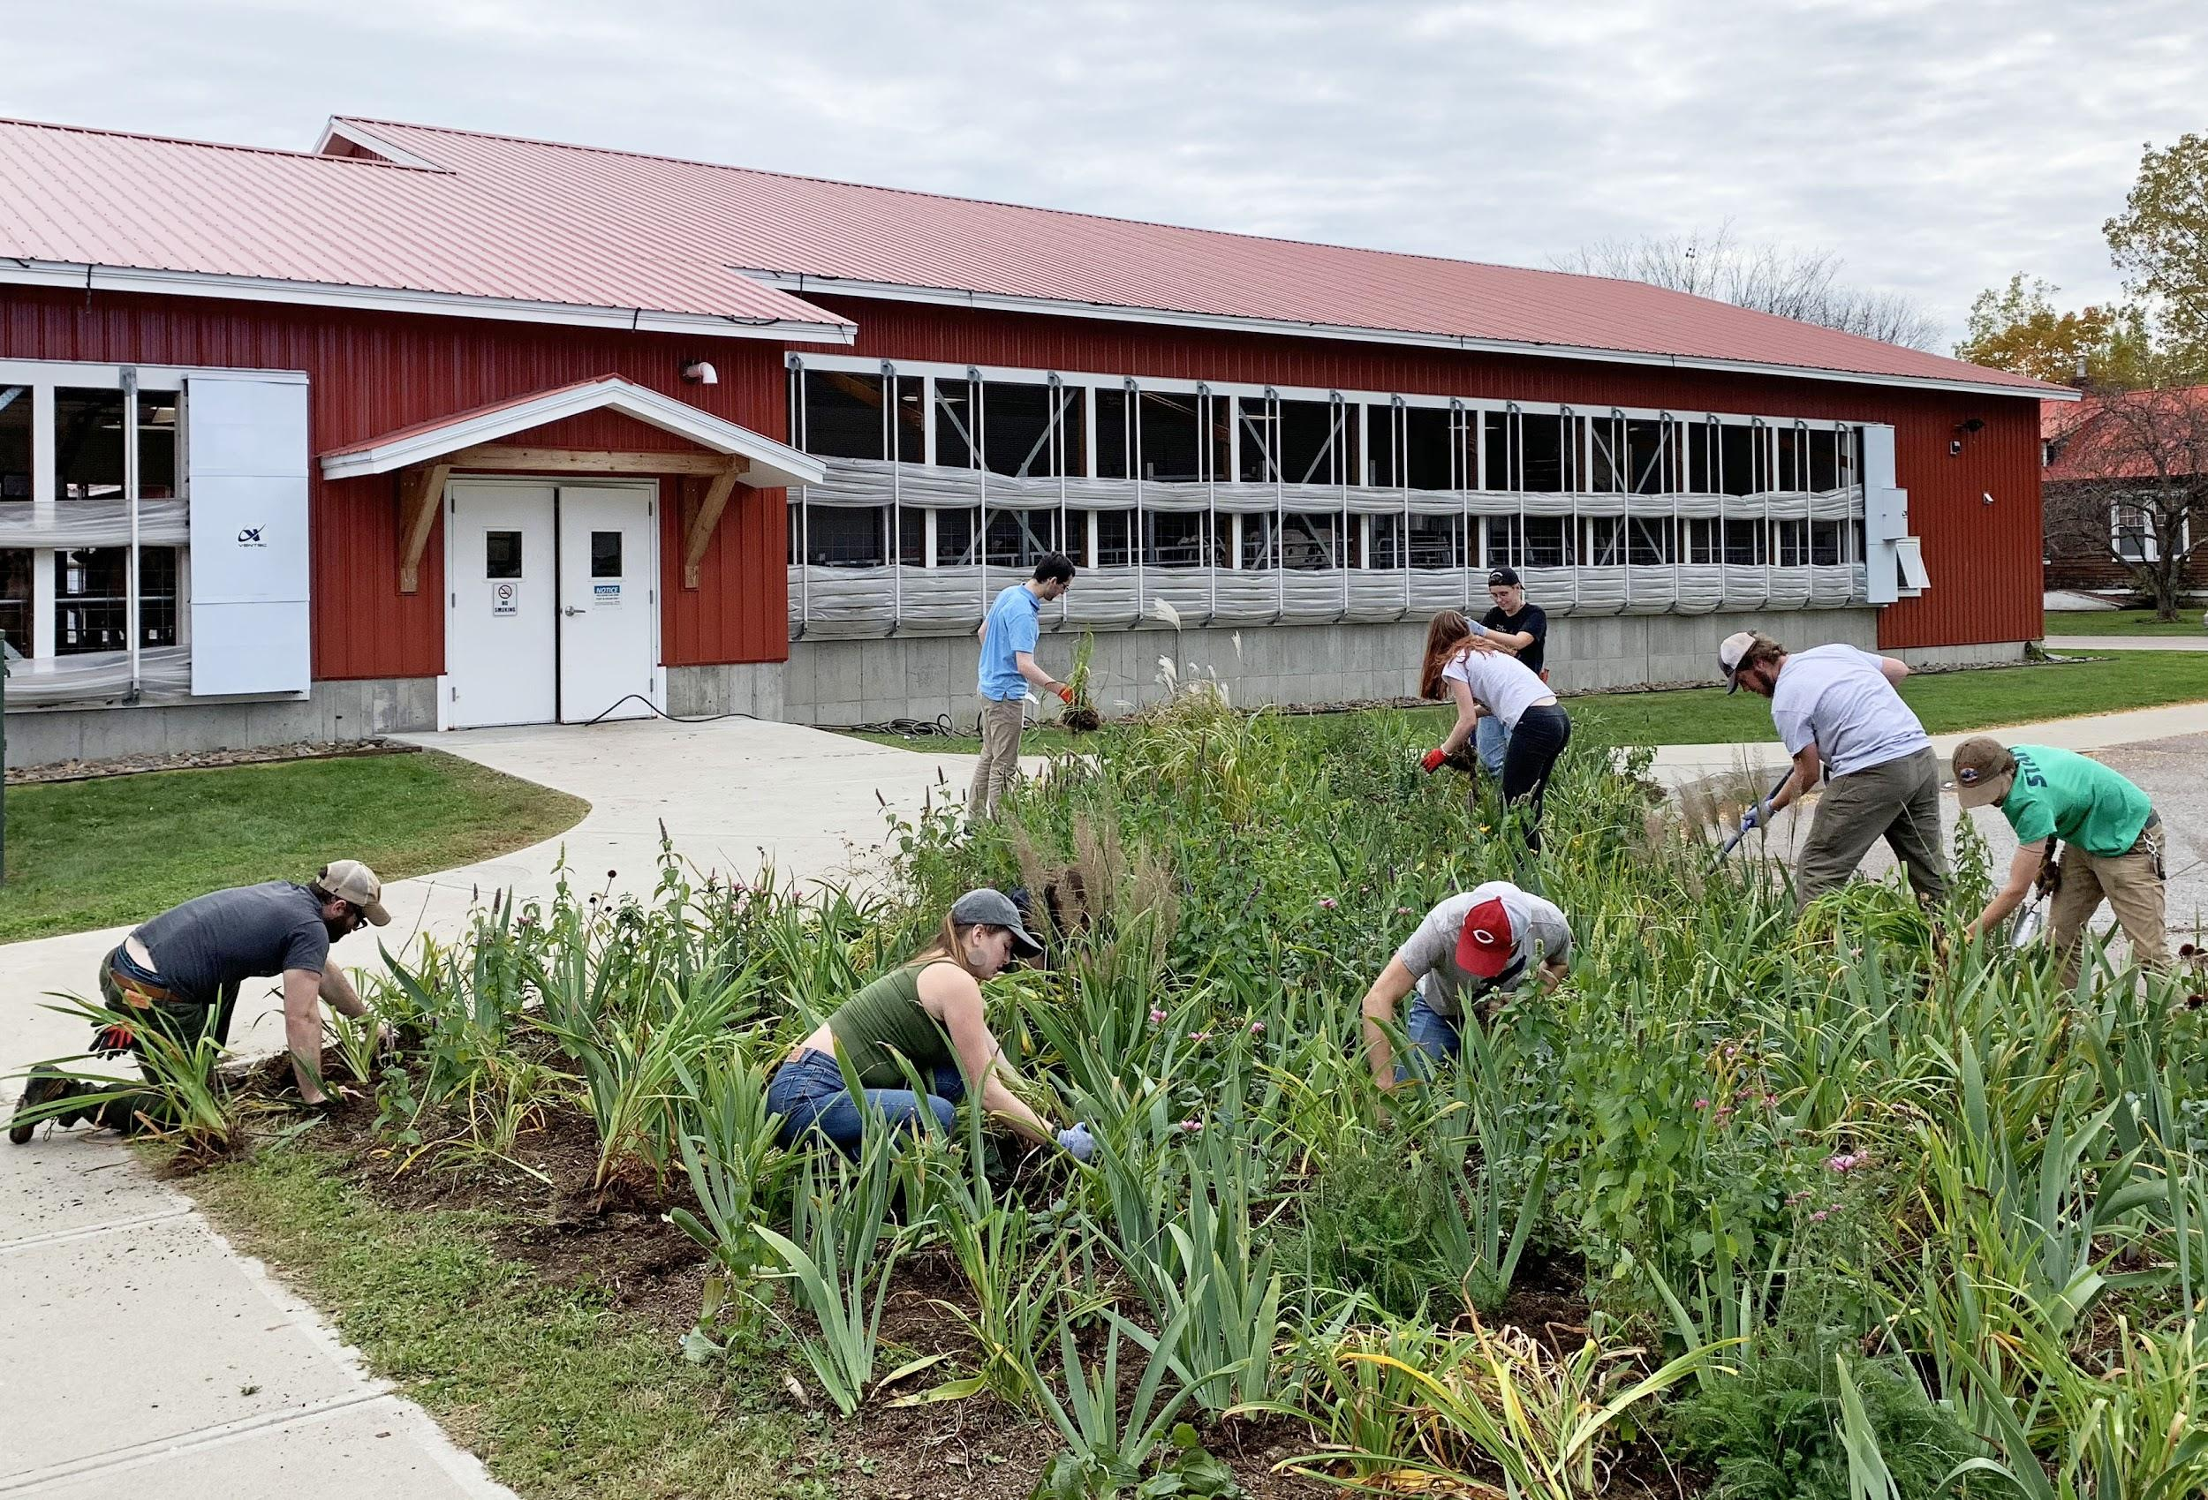
Bee Campus USA Commitments
Create and enhance pollinator habitat on campus through increasing the abundance of native plants and reducing the use of pesticides.
Notes:
Campuses commit to create and enhance pollinator habitat on campus through planting native plants and reducing the use of pesticides.

Slide 35
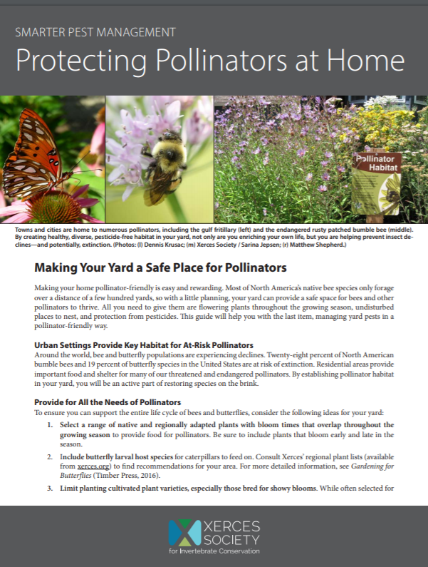
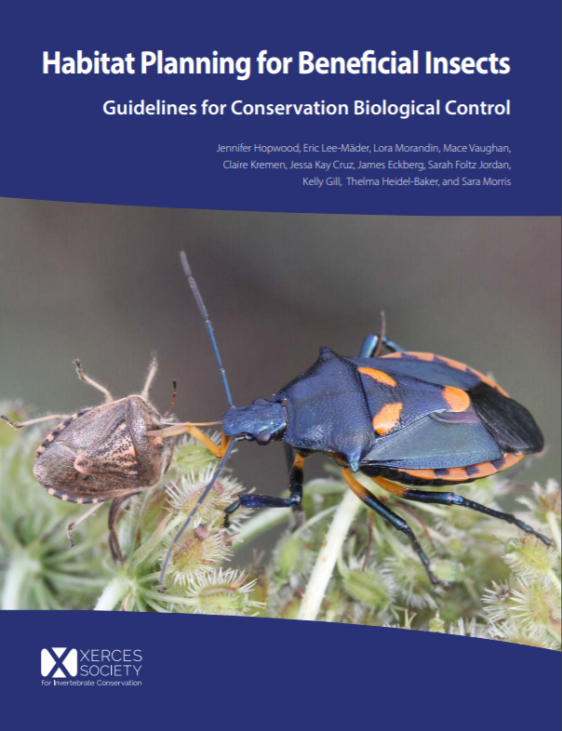
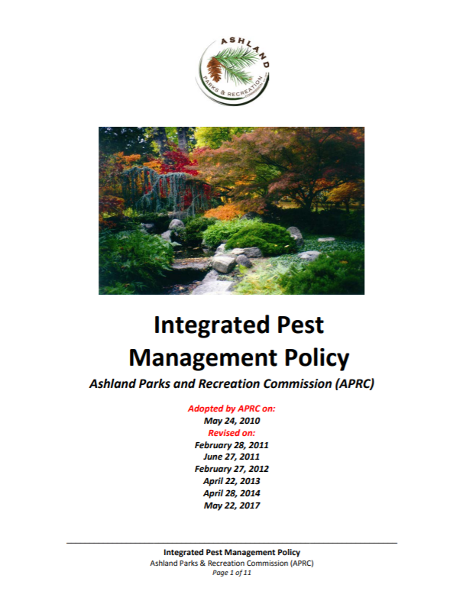
Integrated Pest Management (IPM) Plan
Notes:
Over the first few years of affiliation with Bee Campus USA affiliates create an integrated pest management plan. This plan outlines appropriate uses of pesticides and a plan for using alternatives to pesticides to control pests. The Xerces society has a variety of resources that can help campuses develop an integrated pest management plan.

Slide 36
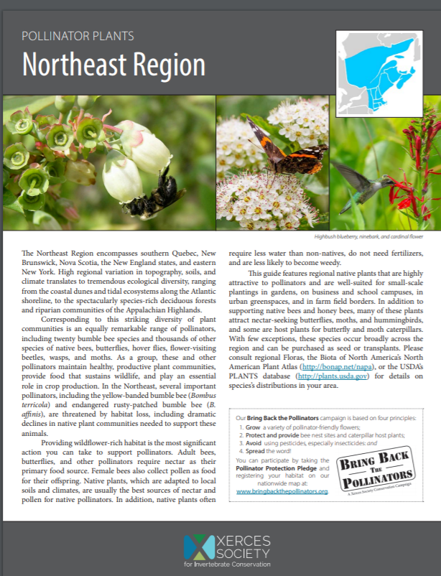
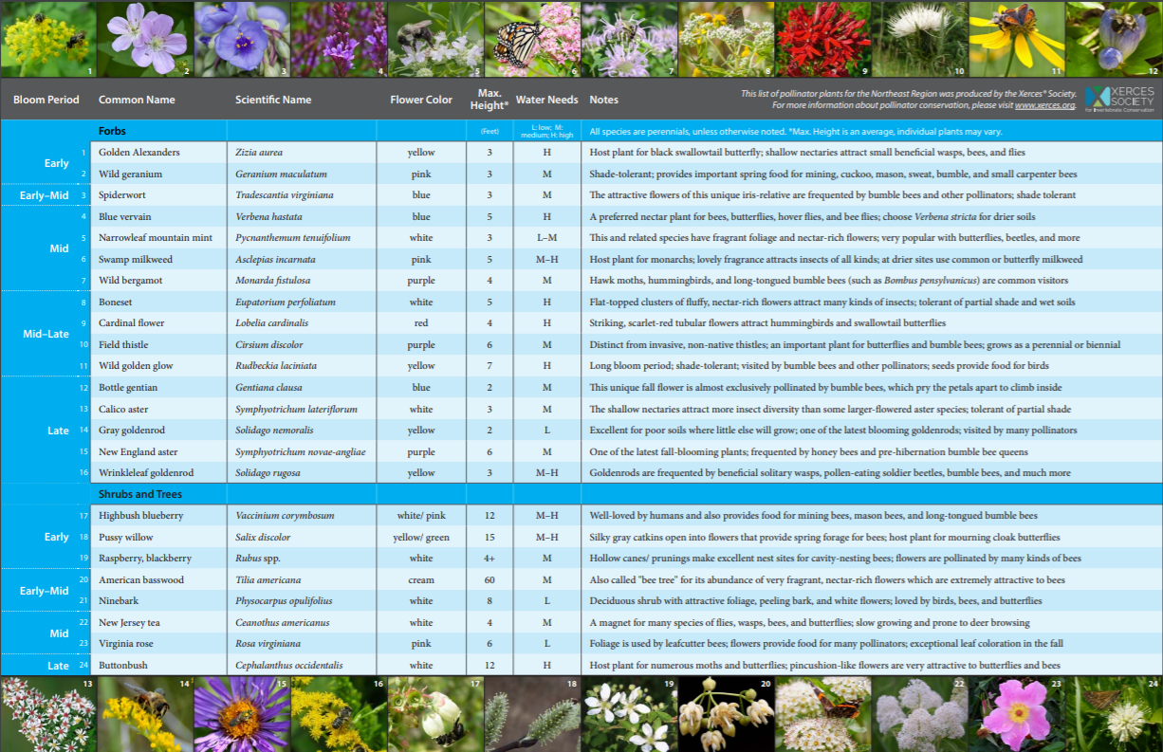
Recommended Native Plant List
Notes:
Affiliates also commit to create a recommended native plant list. This helps the campus community decide what to plant and where they can purchase those plants locally. Xerces has a variety of resources that can help affiliates develop these lists.

Slide 37
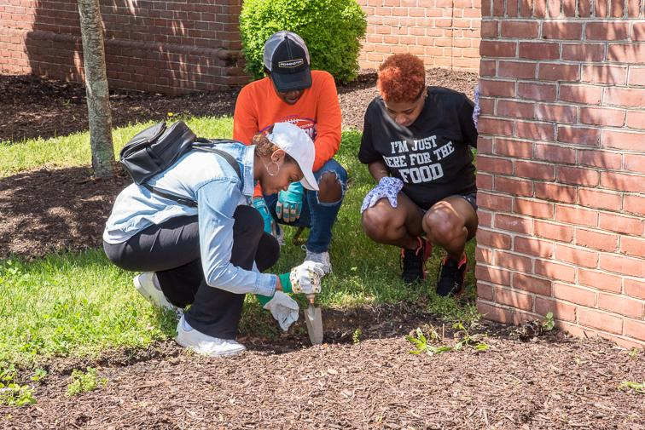
Bee Campus USA Commitments
Offer service-learning projects to enhance pollinator habitat.
Notes:
Campus affiliates offer service-learning projects to enhance pollinator habitat.

Slide 38
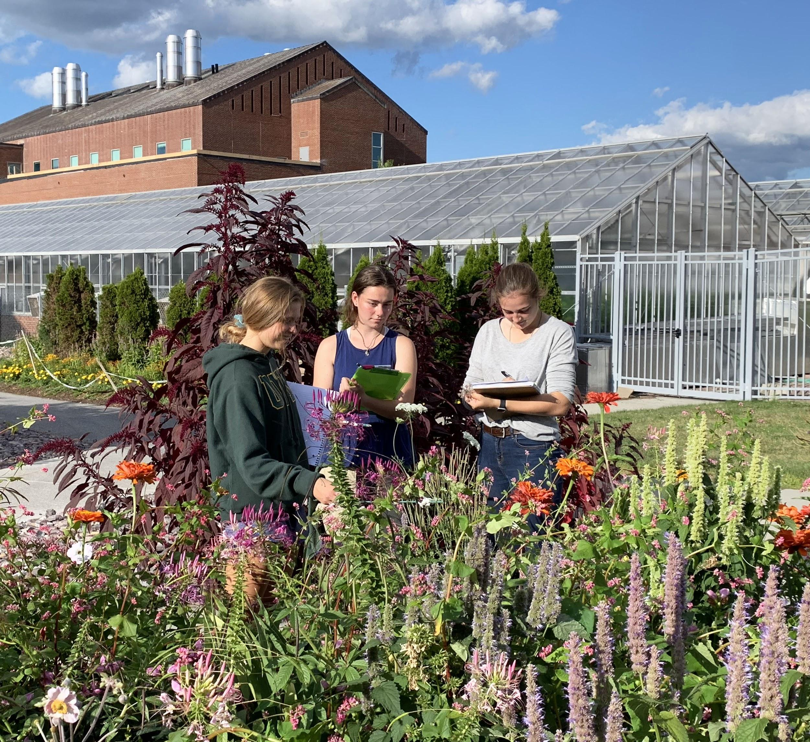
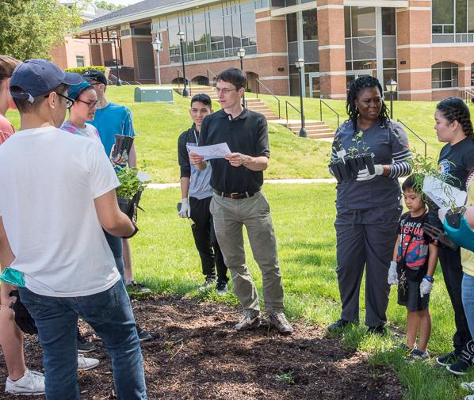
Bee Campus USA Commitments
Offer courses or continuing education opportunities that incorporate pollinator conservation.
Notes:
They also offer courses and continuing education opportunities that incorporate pollinator conservation.

Slide 39
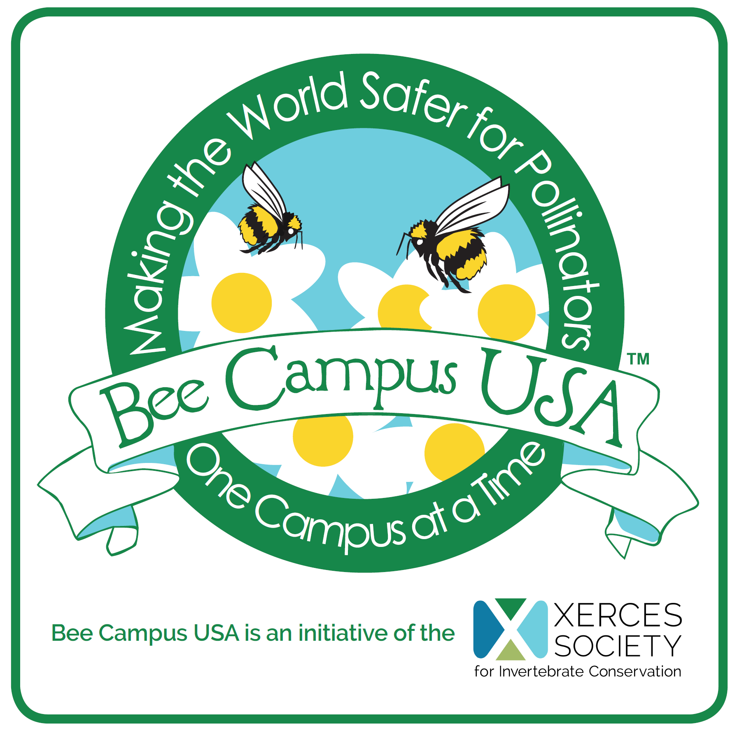
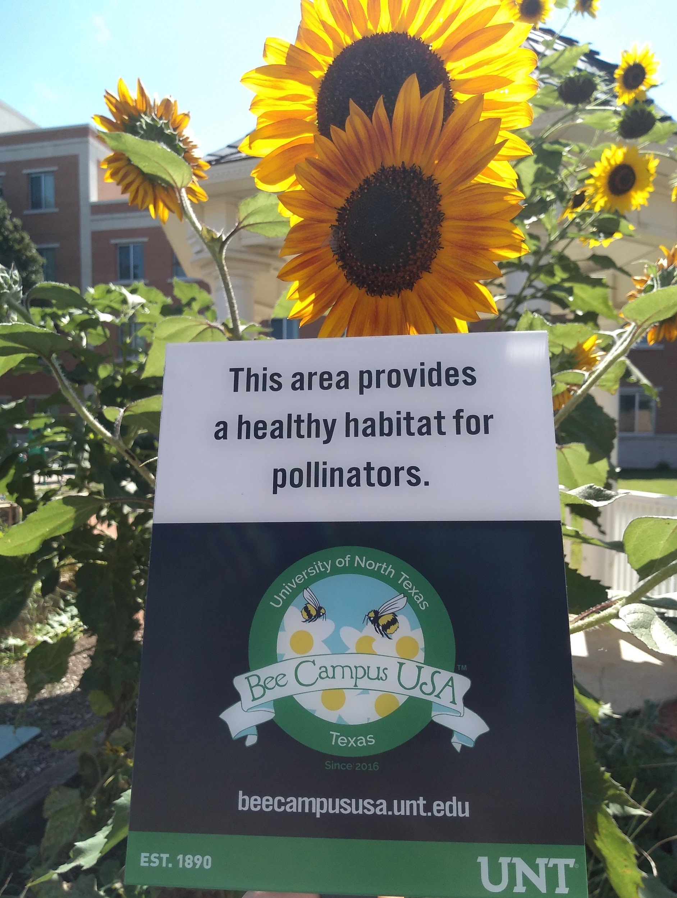
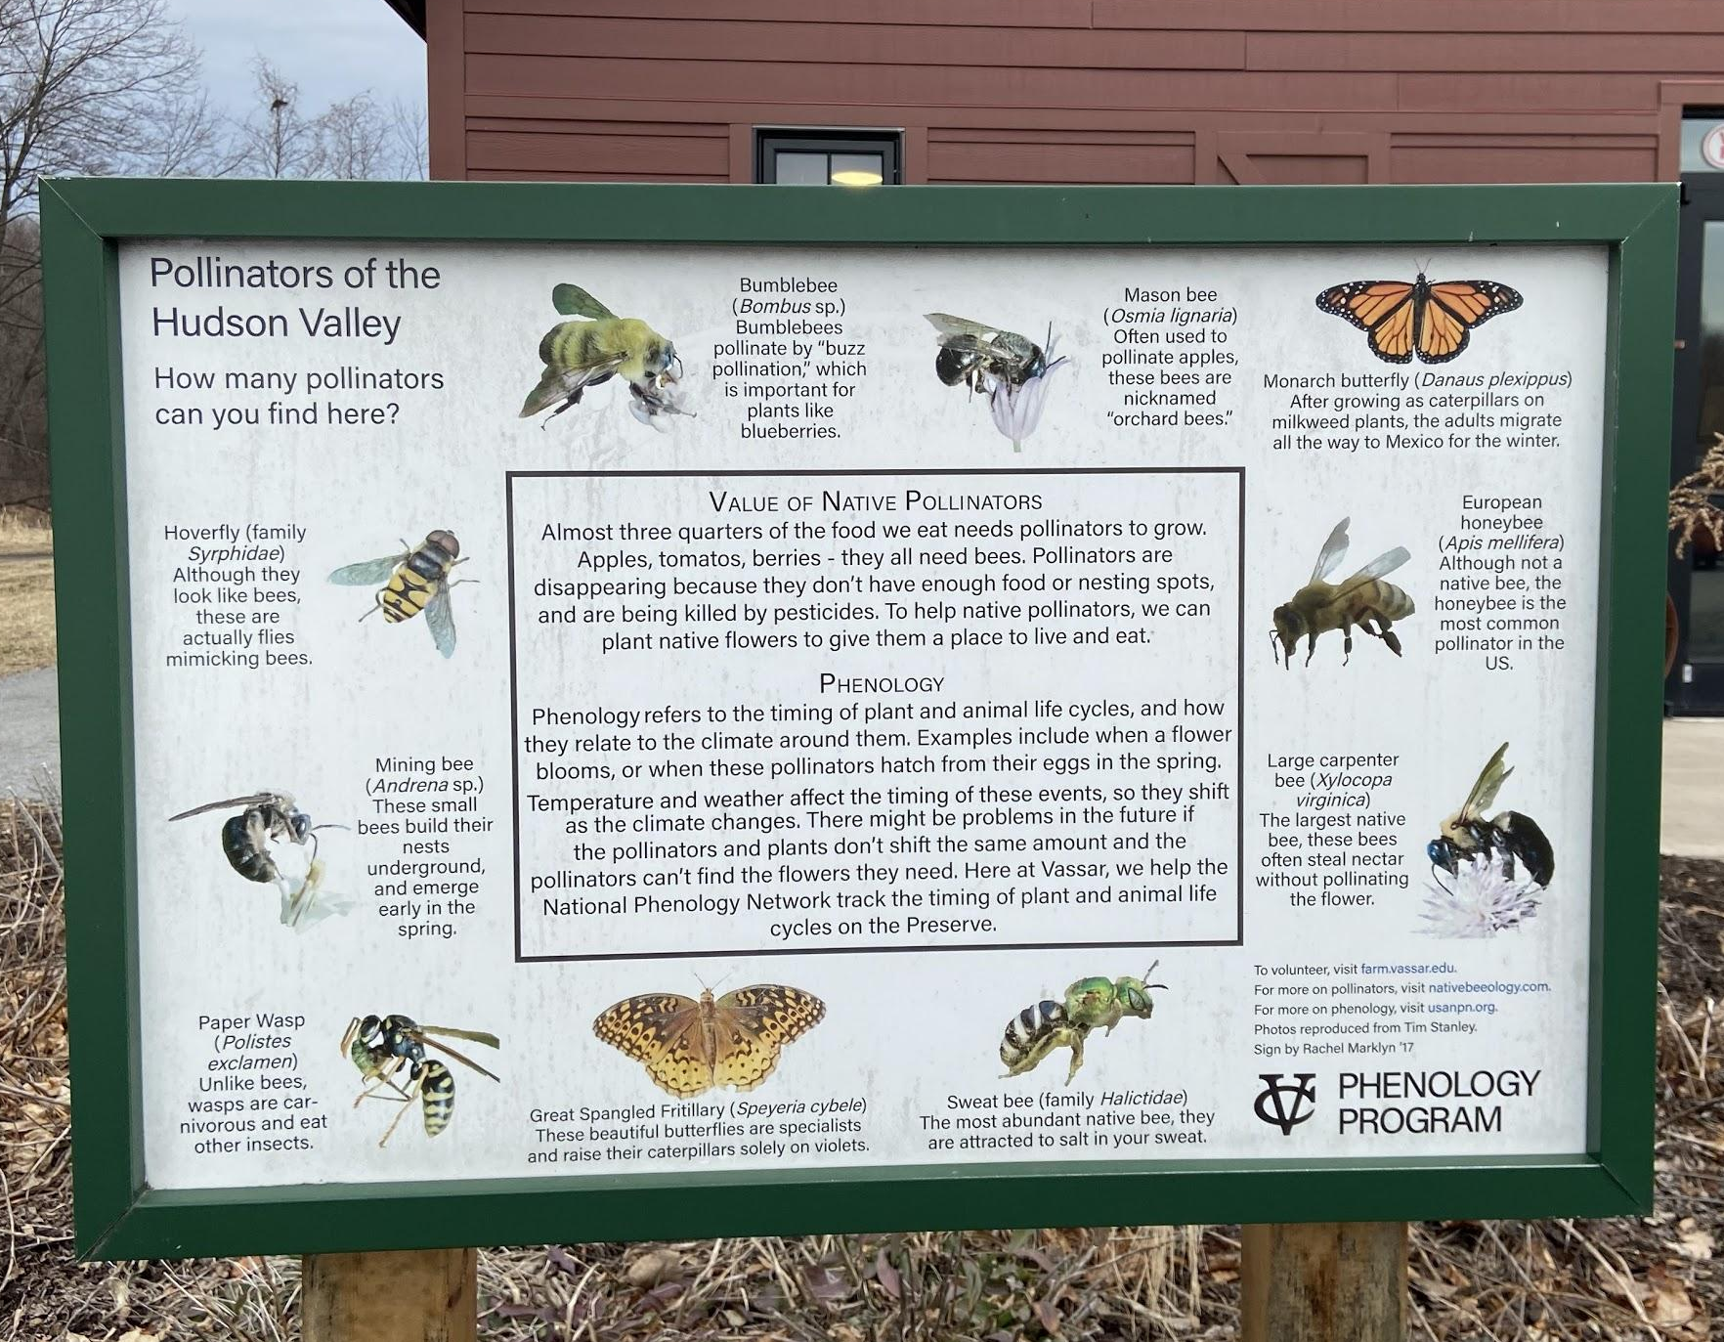
Bee Campus USA Commitments
Publicly acknowledge Bee City USA affiliation with signs and an online presence.
Notes:
Affiliates acknowledge their Bee Campus USA affiliation with signs and an online presence. Xerces provides artwork for signs and affiliates work with local sign makers to get signs made. Affiliates are also encouraged to create signage to educate about pollinators and their habitat.

Slide 40
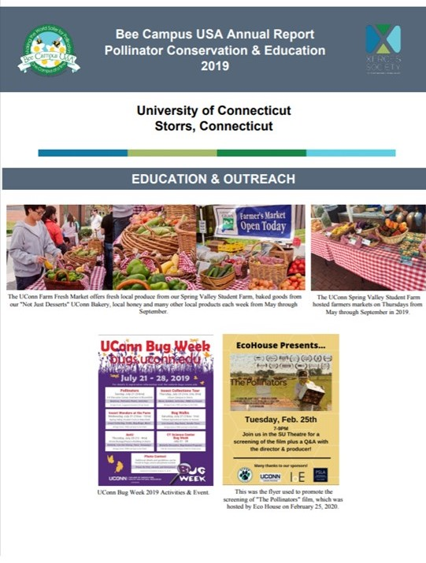
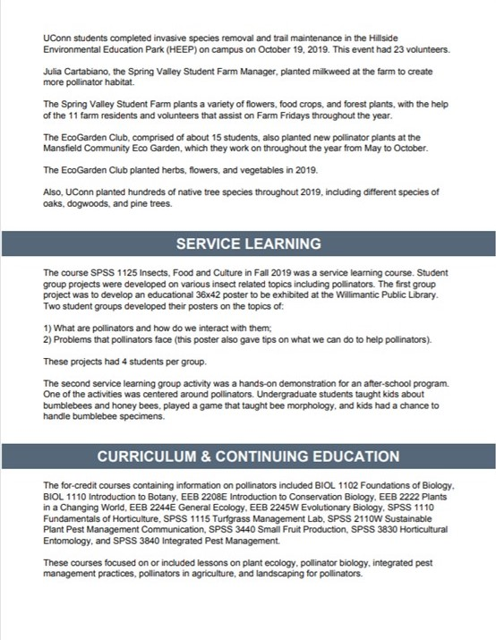
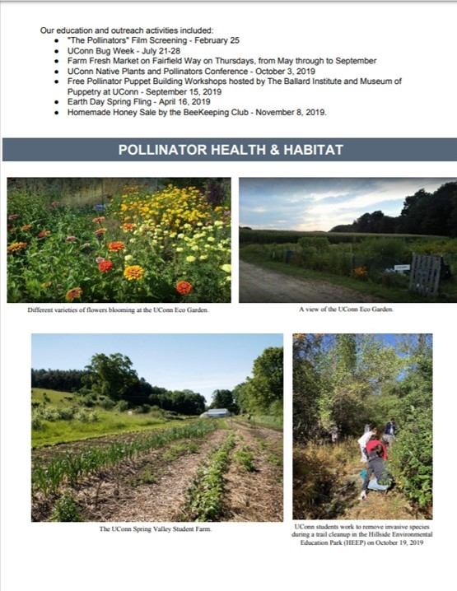
Bee Campus USA Commitments
Annually apply for renewal and report on the previous year’s activities.
Notes:
Campuses must annually apply for renewal and report on the previous year’s activities. The annual report is a form that all cities and campuses must complete by the end of February each year once they have been affiliated with Bee City USA for a full calendar year. These reports allow Bee City USA to make sure affiliates are completing their commitments and also allow affiliates to share the exciting work they’re doing with each other.
Here’s an example of a renewal report for the University of Connecticut. You can view all renewal reports on the Bee City USA website.

Slide 41
Bee Campus USA Commitments
Pay initial application and annual renewal fees.
Fee Based on Enrollment
<3000 ($100)
​3,000 - 5,000 ($200)
5,001 - 10,000 ($300)
10,001 - 20,000 ($400)
>20,000 ($500)
Notes:
Affiliates also pay an initial application fee and annual renewal fee scaled to their student enrollment. These fees help Bee City USA run the program and provide affiliates with advice and resources.

Slide 42
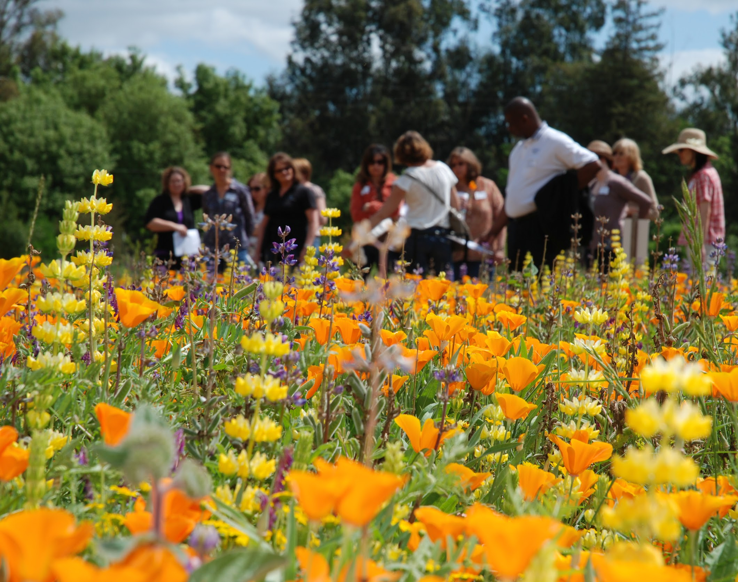
Benefits of Affiliation
Ensure survival of vital animal species including bees and other pollinators.
Build community locally and nationally.
Improve local food production and raise community awareness of how our food grows.
Support small local businesses.
Address pest problems with fewer pesticides using integrated pest management.
Heighten awareness of biological diversity.
Photo: Jim Cairns / USDA-NRCS
Notes:
By becoming an affiliate of Bee Campus USA you:
Ensure survival of vital animal species including bees and other pollinators crucial to the health of our environment.
Build community locally and nationally through bringing your campus together around a positive, shared cause and connect with communities across the country that have made the same commitment.
Improve local food production and raise community awareness of how our food grows.
Support small local businesses including native plant nurseries and pollinator-friendly landscaping.
Address pest problems with fewer pesticides using integrated pest management and
Heighten awareness of biological diversity.
Affiliates also receive support from the Xerces Society. Affiliates can contact Xerces staff anytime to get advice from some of the leading pollinator conservation experts in the country. Affiliates also get access to resources from the Xerces Society including guidelines, fact sheets, webinars, and a monthly e-newsletter.

Slide 43
Apply
www.beecityusa.org/application-campus
Application Process
Form Committee
Complete online application
Receive approval of president or chancellor
Pay application fee (scaled to student enrollment)
Notes:
In order to apply campuses must form a committee, complete an online application, receive approval of the president or chancellor, and pay an application fee. Applicants do not need to have already achieved all of the commitments before applying. The application is essentially a pledge to complete the commitments before the first renewal is due. Participation in the program requires that affiliates complete each commitment each year, but it’s important to remember that this is a long term project, not a race. The number of service learning projects hosted, habitat areas planted, and signs displayed should fit with the committee’s capacity and interests. To be a successful, long term initiative of the campus, the shape that the campus’ involvement takes should be determined by the committee and campus community.

Slide 44
Learn More
www.beecityusa.org
Photo: Sara Morris
Notes:
Visit the Bee City USA website to find more resources, answers to frequently asked questions, and application information.

Slide 45
Thank You
Questions?
Photo: Jennifer Hopwood
Notes:
Thank you for learning more about pollinators and the steps we can all take to conserve them!

